Slide 1
Schema Refinement and
Normal Forms
Notes:
1

Slide 2
The Evils of Redundancy
Redundancy is at the root of several problems associated with relational schemas:
  redundant storage, insert/delete/update anomalies
Integrity constraints, in particular functional dependencies, can be used to identify schemas with such problems and to suggest refinements.
Main refinement technique: decomposition (replacing ABCD with, say, AB and BCD, or ACD and ABD).
Decomposition should be used judiciously:
  Is there reason to decompose a relation?
  What problems (if any) does the decomposition cause?
Notes:
14

Slide 3
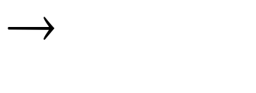
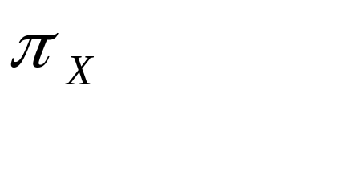

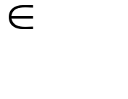
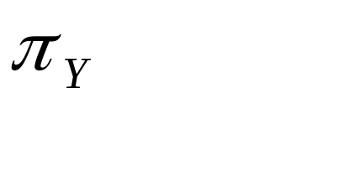
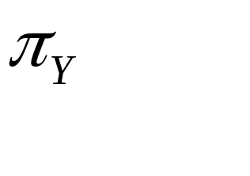
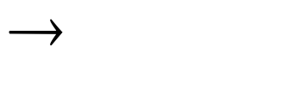
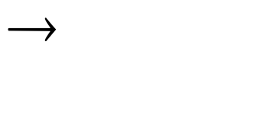
Functional Dependencies (FDs)
A functional dependency X Y holds over relation R if, for every allowable instance r of R:
  t1 r, t2 r, (t1) = (t2) implies
  (t1) = (t2)
  i.e., given two tuples in r, if the X values agree, then the Y values must also agree. (X and Y are sets of attributes.)
An FD is a statement about all allowable relations.
  Must be identified based on semantics of application.
  Given some allowable instance r1 of R, we can check if it violates some FD f, but we cannot tell if f holds over R!
K is a candidate key for R means that K R
  However, K R does not require K to be minimal!
Notes:
15

Slide 4

Example: Constraints on Entity Set
Consider relation obtained from Hourly_Emps:
  Hourly_Emps (ssn, name, lot, rating, hrly_wages, hrs_worked)
Notation: We will denote this relation schema by listing the attributes: SNLRWH
  This is really the set of attributes {S,N,L,R,W,H}.
  Sometimes, we will refer to all attributes of a relation by using the relation name. (e.g., Hourly_Emps for SNLRWH)
Some FDs on Hourly_Emps:
  ssn is the key: S SNLRWH
  rating determines hrly_wages: R W
Notes:
16

Slide 5
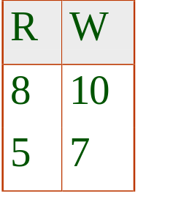
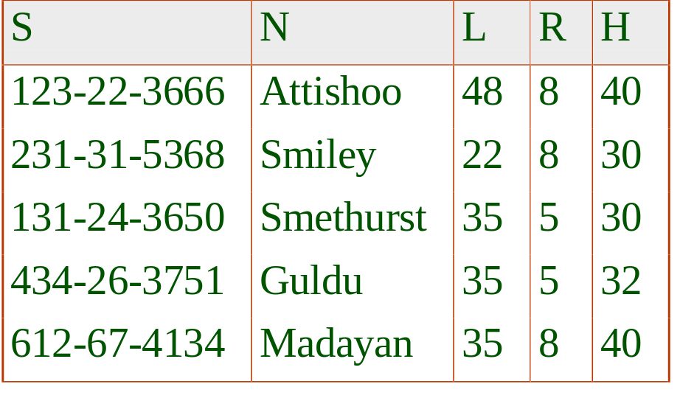

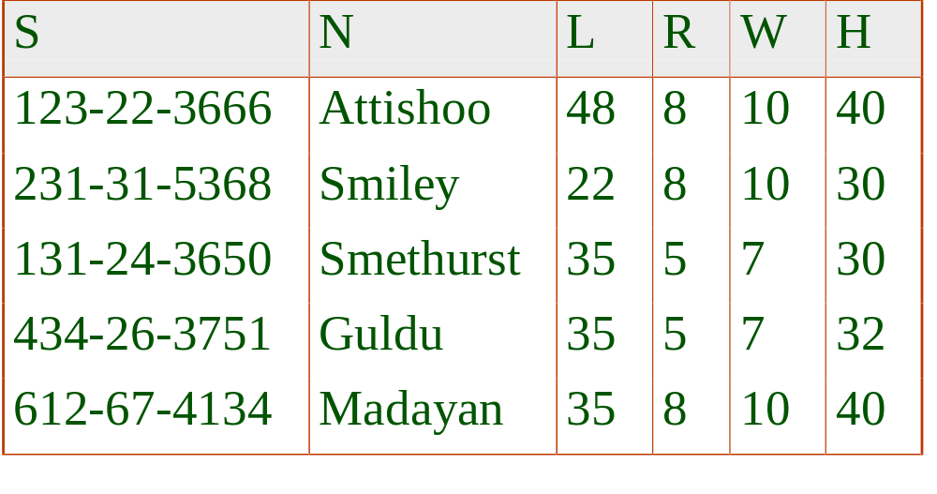
Example (Contd.)
Wages
Hourly_Emps2
Problems due to R W :
  Update anomaly: Can we change W in just the 1st tuple of SNLRWH?
  Insertion anomaly: What if we want to insert an employee and don’t know the hourly wage for his rating?
  Deletion anomaly: If we delete all employees with rating 5, we lose the information about the wage for rating 5!
Will 2 smaller tables be better?
Notes:
17

Slide 6
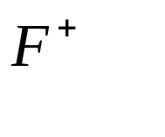
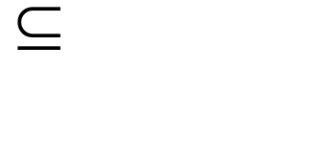
Reasoning About FDs
Given some FDs, we can usually infer additional FDs:
  ssn did, did lot implies ssn lot
An FD f is implied by a set of FDs F if f holds whenever all FDs in F hold.
  = closure of F is the set of all FDs that are implied by F.
Armstrong’s Axioms (X, Y, Z are sets of attributes):
  Reflexivity: If X Y, then Y X
  Augmentation: If X Y, then XZ YZ for any Z
  Transitivity: If X Y and Y Z, then X Z
These are sound and complete inference rules for FDs!
Notes:
19

Slide 7
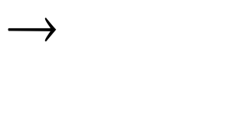

Reasoning About FDs (Contd.)
Couple of additional rules (that follow from AA):
  Union: If X Y and X Z, then X YZ
  Decomposition: If X YZ, then X Y
  and X Z
Example: Contracts(cid,sid,jid,did,pid,qty,value), and:
  C is the key: C CSJDPQV
  Project purchases each part using single contract:
  JP C
  Dept purchases at most one part from a supplier:
  SD P
JP C, C CSJDPQV imply JP CSJDPQV
SD P implies SDJ JP
SDJ JP, JP CSJDPQV imply SDJ CSJDPQV
Notes:
20

Slide 8
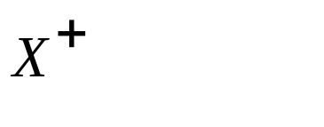
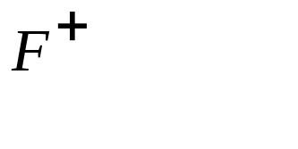



Reasoning About FDs (Contd.)
Computing the closure of a set of FDs can be expensive. (Size of closure is exponential in # attrs!)
Typically, we just want to check if a given FD X Y is in the closure of a set of FDs F. An efficient check:
  Compute attribute closure of X (denoted ) wrt F:
    Set of all attributes A such that X A is in
    There is a linear time algorithm to compute this.
  Check if Y is in
Does F = {A B, B C, C D E } imply A E?
  i.e, is A E in the closure ? Equivalently, is E in ?
Notes:
21

Slide 9
Normal Forms
Returning to the issue of schema refinement, the first question to ask is whether any refinement is needed!
If a relation is in a certain normal form (BCNF, 3NF etc.), it is known that certain kinds of problems are avoided/minimized. This can be used to help us decide whether decomposing the relation will help.
Role of FDs in detecting redundancy:
  Consider a relation R with 3 attributes, ABC.
    No FDs hold: There is no redundancy here.
    Given A B: Several tuples could have the same A value, and if so, they’ll all have the same B value!
Notes:
22

Slide 10
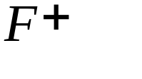

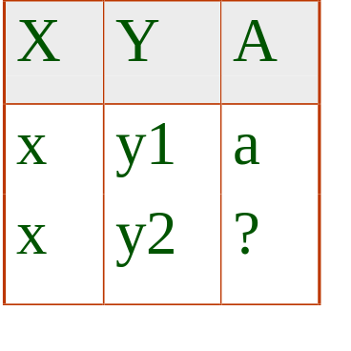
Boyce-Codd Normal Form (BCNF)
Reln R with FDs F is in BCNF if, for all X A in
  A X (called a trivial FD), or
  X contains a key for R.
In other words, R is in BCNF if the only non-trivial FDs that hold over R are key constraints.
  No dependency in R that can be predicted using FDs alone.
  If we are shown two tuples that agree upon the X value, we cannot infer the A value in one tuple from the A value in the other.
  If example relation is in BCNF, the 2 tuples must be identical (since X is a key).
Notes:
23

Slide 11
Third Normal Form (3NF)
Reln R with FDs F is in 3NF if, for all X A in
  A X (called a trivial FD), or
  X contains a key for R, or
  A is part of some key for R.
Minimality of a key is crucial in third condition above!
If R is in BCNF, obviously in 3NF.
If R is in 3NF, some redundancy is possible. It is a compromise, used when BCNF not achievable (e.g., no ``good’’ decomp, or performance considerations).
  Lossless-join, dependency-preserving decomposition of R into a collection of 3NF relations always possible.
Notes:
24

Slide 12
What Does 3NF Achieve?
If 3NF violated by X A, one of the following holds:
  X is a subset of some key K
    We store (X, A) pairs redundantly.
  X is not a proper subset of any key.
    There is a chain of FDs K X A, which means that we cannot associate an X value with a K value unless we also associate an A value with an X value.
But: even if reln is in 3NF, these problems could arise.
  e.g., Reserves SBDC, S C, C S is in 3NF, but for each reservation of sailor S, same (S, C) pair is stored.
Thus, 3NF is indeed a compromise relative to BCNF.
Notes:
25

Slide 13
Decomposition of a Relation Scheme
Suppose that relation R contains attributes A1 ... An. A decomposition of R consists of replacing R by two or more relations such that:
  Each new relation scheme contains a subset of the attributes of R (and no attributes that do not appear in R), and
  Every attribute of R appears as an attribute of one of the new relations.
Intuitively, decomposing R means we will store instances of the relation schemes produced by the decomposition, instead of instances of R.
E.g., Can decompose SNLRWH into SNLRH and RW.
Notes:
26

Slide 14

Example Decomposition
Decompositions should be used only when needed.
  SNLRWH has FDs S SNLRWH and R W
  Second FD causes violation of 3NF; W values repeatedly associated with R values. Easiest way to fix this is to create a relation RW to store these associations, and to remove W from the main schema:
    i.e., we decompose SNLRWH into SNLRH and RW
The information to be stored consists of SNLRWH tuples. If we just store the projections of these tuples onto SNLRH and RW, are there any potential problems that we should be aware of?
Notes:
27

Slide 15
Problems with Decompositions
There are three potential problems to consider:
  Some queries become more expensive.
    e.g., How much did sailor Joe earn? (salary = W*H)
  Given instances of the decomposed relations, we may not be able to reconstruct the corresponding instance of the original relation!
    Fortunately, not in the SNLRWH example.
  Checking some dependencies may require joining the instances of the decomposed relations.
    Fortunately, not in the SNLRWH example.
Tradeoff: Must consider these issues vs. redundancy.
Notes:
28

Slide 16
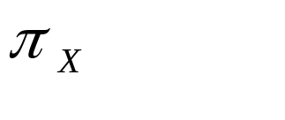
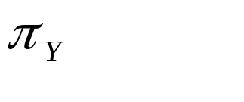



Lossless Join Decompositions
Decomposition of R into X and Y is lossless-join w.r.t. a set of FDs F if, for every instance r that satisfies F:
  (r) (r) = r
It is always true that r (r) (r)
  In general, the other direction does not hold! If it does, the decomposition is lossless-join.
Definition extended to decomposition into 3 or more relations in a straightforward way.
It is essential that all decompositions used to deal with redundancy be lossless! (Avoids Problem (2).)
Notes:
29

Slide 17
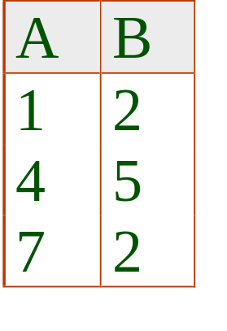
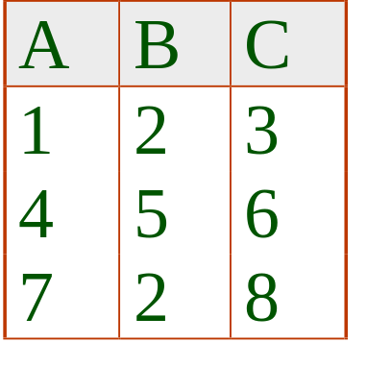
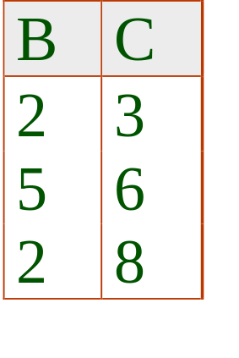
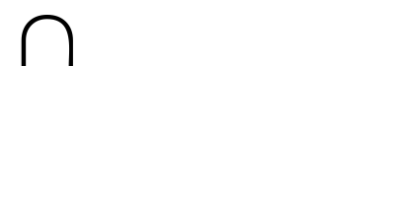
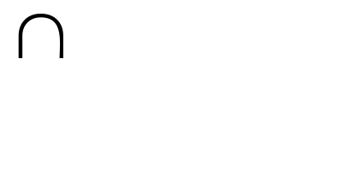
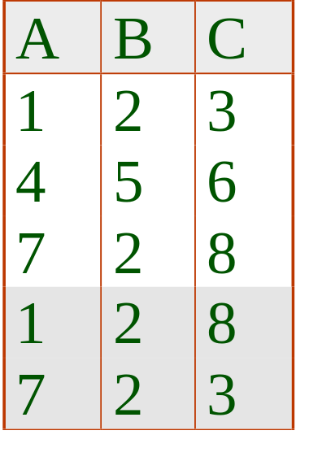
More on Lossless Join
The decomposition of R into X and Y is lossless-join wrt F if and only if the closure of F contains:
  X Y X, or
  X Y Y
In particular, the decomposition of R into UV and R - V is lossless-join if U V holds over R.
Notes:
30

Slide 18
Dependency Preserving Decomposition
Consider CSJDPQV, C is key, JP C and SD P.
  BCNF decomposition: CSJDQV and SDP
  Problem: Checking JP C requires a join!
Dependency preserving decomposition (Intuitive):
  If R is decomposed into X, Y and Z, and we enforce the FDs that hold on X, on Y and on Z, then all FDs that were given to hold on R must also hold. (Avoids Problem (3).)
Projection of set of FDs F: If R is decomposed into X, ... projection of F onto X (denoted F_{X} ) is the set of FDs U V in F⁺ (closure of F ) such that U, V are in X.
Notes:
3

Slide 19
Dependency Preserving Decompositions
(Contd.)
Decomposition of R into X and Y is dependency preserving if (F_{X} union F_{Y} ) ⁺ = F ⁺
  i.e., if we consider only dependencies in the closure F ⁺ that can be checked in X without considering Y, and in Y without considering X, these imply all dependencies in F ⁺.
Important to consider F ⁺, not F, in this definition:
  ABC, A B, B C, C A, decomposed into AB and BC.
  Is this dependency preserving? Is C A preserved?????
Dependency preserving does not imply lossless join:
  ABC, A B, decomposed into AB and BC.
And vice-versa! (Example?)
Notes:
4

Slide 20
Decomposition into BCNF
Consider relation R with FDs F. If X Y violates BCNF, decompose R into R - Y and XY.
  Repeated application of this idea will give us a collection of relations that are in BCNF; lossless join decomposition, and guaranteed to terminate.
  e.g., CSJDPQV, key C, JP C, SD P, J S
  To deal with SD P, decompose into SDP, CSJDQV.
  To deal with J S, decompose CSJDQV into JS and CJDQV
In general, several dependencies may cause violation of BCNF. The order in which we ``deal with’’ them could lead to very different sets of relations!
Notes:
5

Slide 21
BCNF and Dependency Preservation
In general, there may not be a dependency preserving decomposition into BCNF.
  e.g., CSZ, CS Z, Z C
  Can’t decompose while preserving 1st FD; not in BCNF.
Similarly, decomposition of CSJDQV into SDP, JS and CJDQV is not dependency preserving (w.r.t. the FDs JP C, SD P and J S).
  However, it is a lossless join decomposition.
  In this case, adding JPC to the collection of relations gives us a dependency preserving decomposition.
    JPC tuples stored only for checking FD! (Redundancy!)
Notes:
6

Slide 22
Decomposition into 3NF
Obviously, the algorithm for lossless join decomp into BCNF can be used to obtain a lossless join decomp into 3NF (typically, can stop earlier).
To ensure dependency preservation, one idea:
  If X Y is not preserved, add relation XY.
  Problem is that XY may violate 3NF! e.g., consider the addition of CJP to `preserve’ JP C. What if we also have J C ?
Refinement: Instead of the given set of FDs F, use a minimal cover for F.
Notes:
7

Slide 23
Minimal Cover for a Set of FDs
Minimal cover G for a set of FDs F:
  Closure of F = closure of G.
  Right hand side of each FD in G is a single attribute.
  If we modify G by deleting an FD or by deleting attributes from an FD in G, the closure changes.
Intuitively, every FD in G is needed, and ``as small as possible’’ in order to get the same closure as F.
e.g., A B, ABCD E, EF GH,
ACDF EG has the following minimal cover:
  A B, ACD E, EF G and EF H
M.C. → Lossless-Join, Dep. Pres. Decomp!!! (in book)
Notes:
8

Slide 24
Refining an ER Diagram
1st diagram translated: Workers(S,N,L,D,S) Departments(D,M,B)
  Lots associated with workers.
Suppose all workers in a dept are assigned the same lot: D L
Redundancy; fixed by: Workers2(S,N,D,S) Dept_Lots(D,L)
Can fine-tune this: Workers2(S,N,D,S) Departments(D,M,B,L)
Before:
since
name
dname
ssn
lot
did
budget
Employees
Works_In
Departments
After:
budget
since
name
dname
ssn
did
lot
Employees
Works_In
Departments
Notes:
18

Slide 25
Summary of Schema Refinement
If a relation is in BCNF, it is free of redundancies that can be detected using FDs. Thus, trying to ensure that all relations are in BCNF is a good heuristic.
If a relation is not in BCNF, we can try to decompose it into a collection of BCNF relations.
  Must consider whether all FDs are preserved. If a lossless-join, dependency preserving decomposition into BCNF is not possible (or unsuitable, given typical queries), should consider decomposition into 3NF.
  Decompositions should be carried out and/or re-examined while keeping performance requirements in mind.
Notes:
9

